Slide 1
Climate Data with the KrigR Pipeline
Efficient Data Retrieval and Processing for individual study requirements
Erik Kusch, PhD Student Department of Biology Section for Ecoinformatics & Biodiversity
Center for Biodiversity Dynamics in a Changing World (BIOCHANGE) Aarhus University

Slide 2

Data Requirements for the 21st century
Holy Trinity of Climate Data
Variables
Resolution
Accuracy

Slide 3
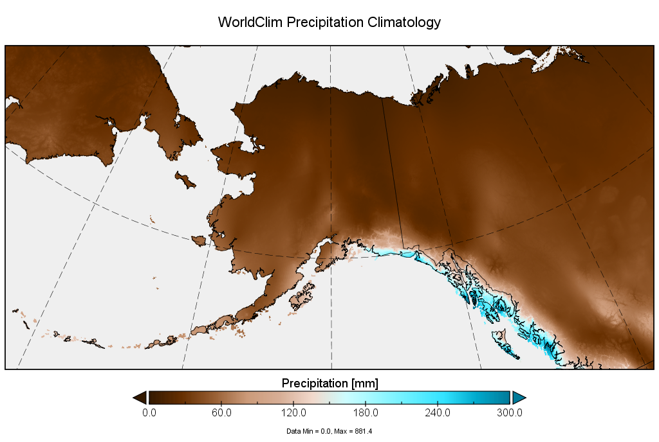
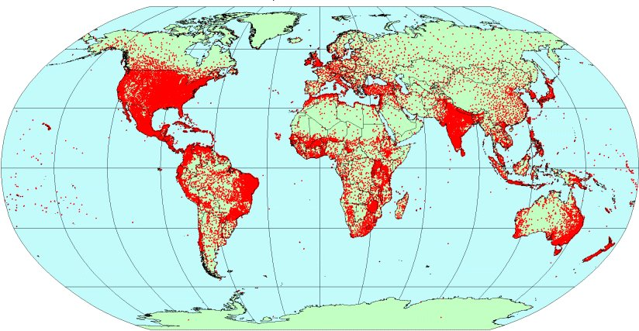
Contemporary Data - Accuracy
Large areas of legacy data sets suffer from low reliability
No data uncertainty/quality markers
Spatial resolutions: 1x1km
→ Too tough for data sources and interpolation techniques used for legacy data

Slide 4
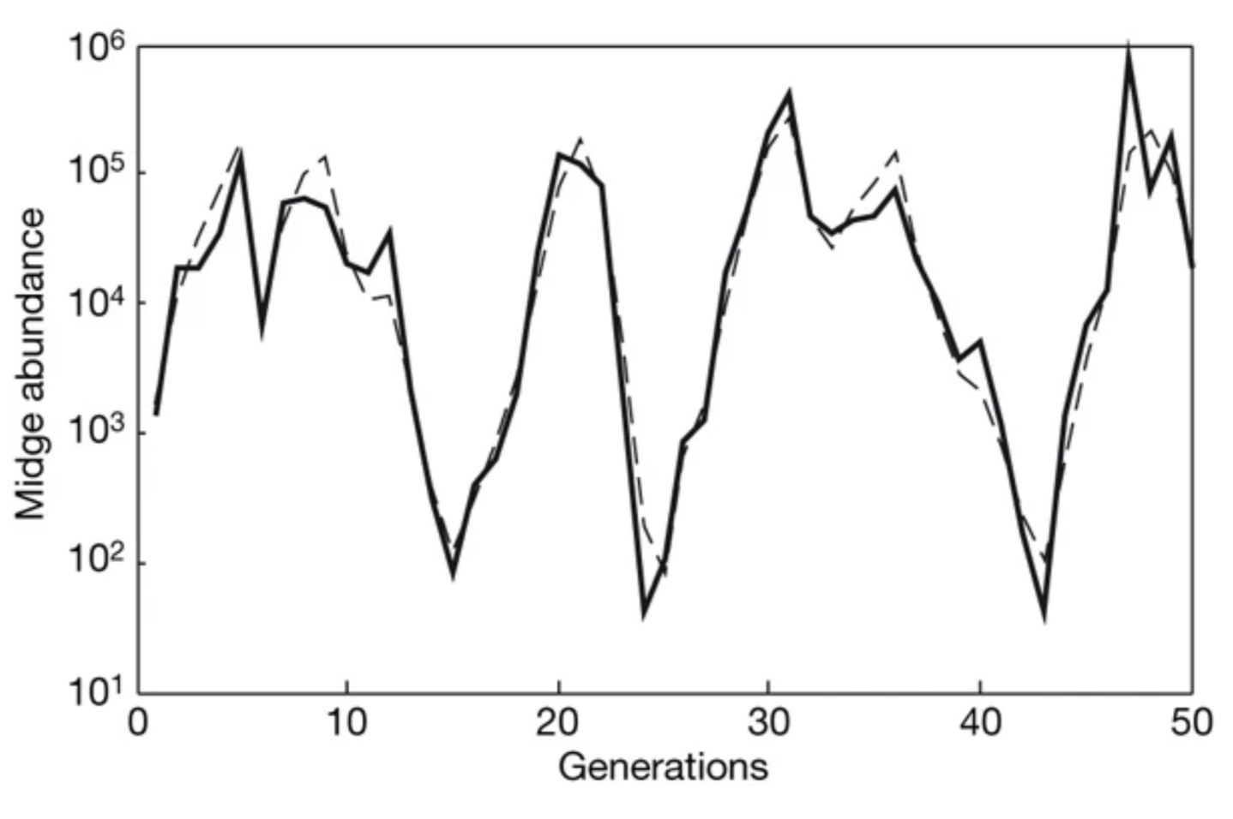
Contemporary Data – Temporal Resolution
Most legacy data sets offer monthly intervals of data
Natural processes rarely happen at neat monthly intervals
Temporal variability must be accounted for in quantification of extreme events
Biologically relevant gaps:
Extreme Events:
Neutral
Rapid
Growth
Rapid
Decline
© Connor Bernard
© Connor Bernard

Slide 5




Contemporary Data – Variables
ECVs offered by legacy data sets:
e.g.: WorldClim: ~26 variables
Mostly raw data and derivatives of:
Air Temperature
Precipitation
Data is rarely available at higher resolutions than monthly intervals
Much of this data is interpolated
Problematic with certain ECVs
Interpolation methods usually not made publicly available
Legacy data sets offer insufficient coverage of the ECV spectrum
ECVs offered by legacy data sets:
e.g.: WorldClim: ~25 climate variables
19 bioclimatic variables
Mostly raw data and derivatives of:
Air Temperature
Precipitation
Environments
Research
…
Wind
Radiation

Slide 6




The Holy Trinity & Reformation Needs
Variables
Come on, man.
Resolution
Accuracy

Slide 7

Climate Reanalyses are the Solution
Variables offered by climate reanalyses:
e.g.: ERA5(-Land): ~83 variables
Covering all ECVs indexing important components of ecosystems such as:
Atmosphere
Soil properties
Resolution:
Space: 9km
Time: hourly intervals
Accuracy:
Good fit to nature due to data assimilation practices

Slide 8
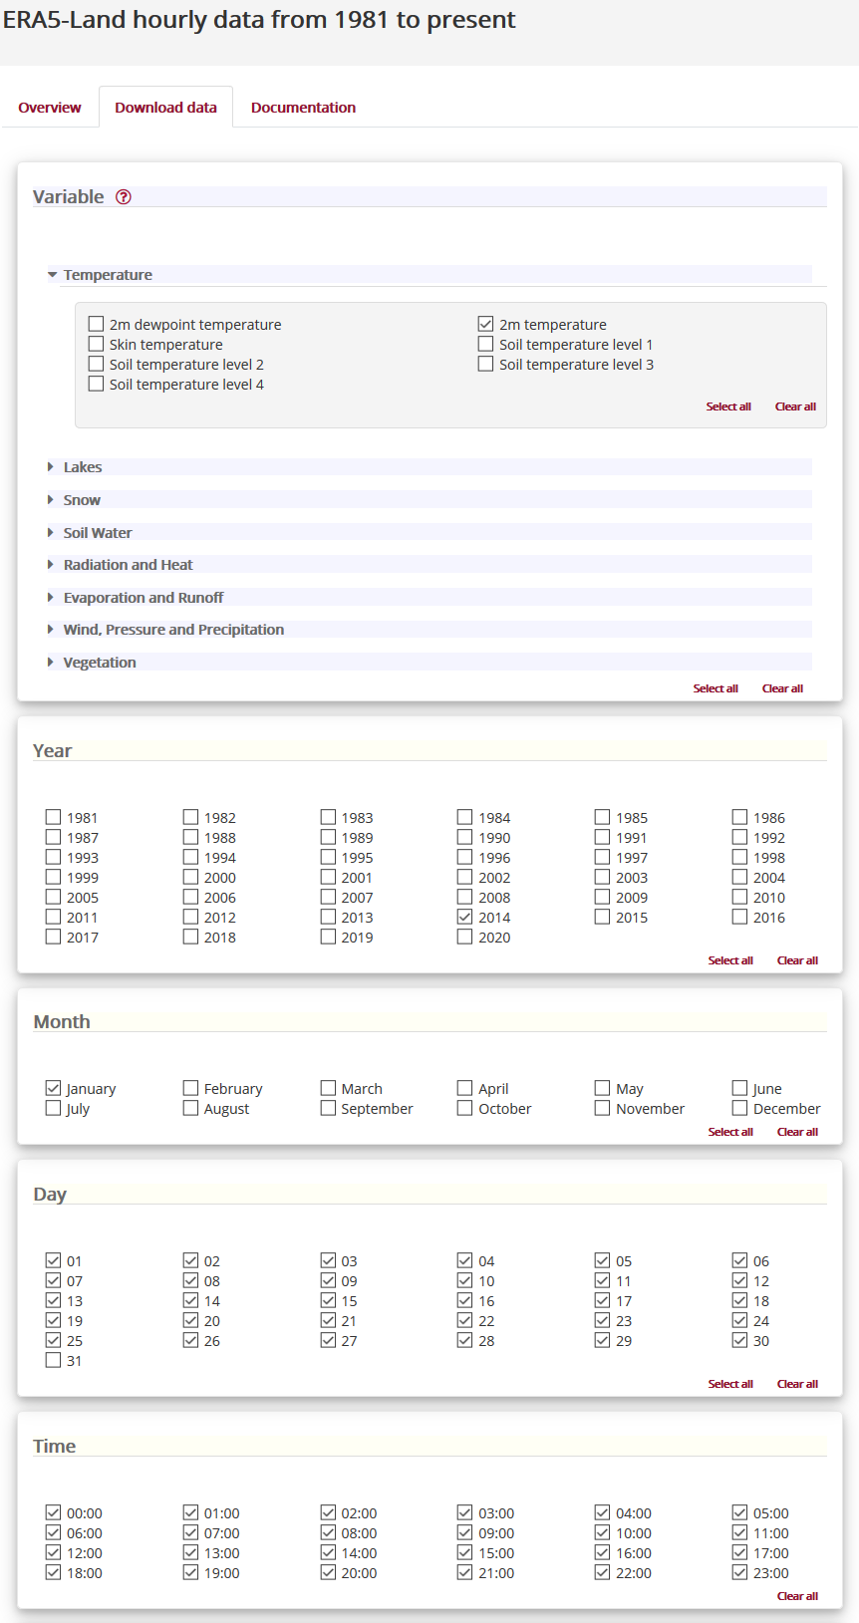
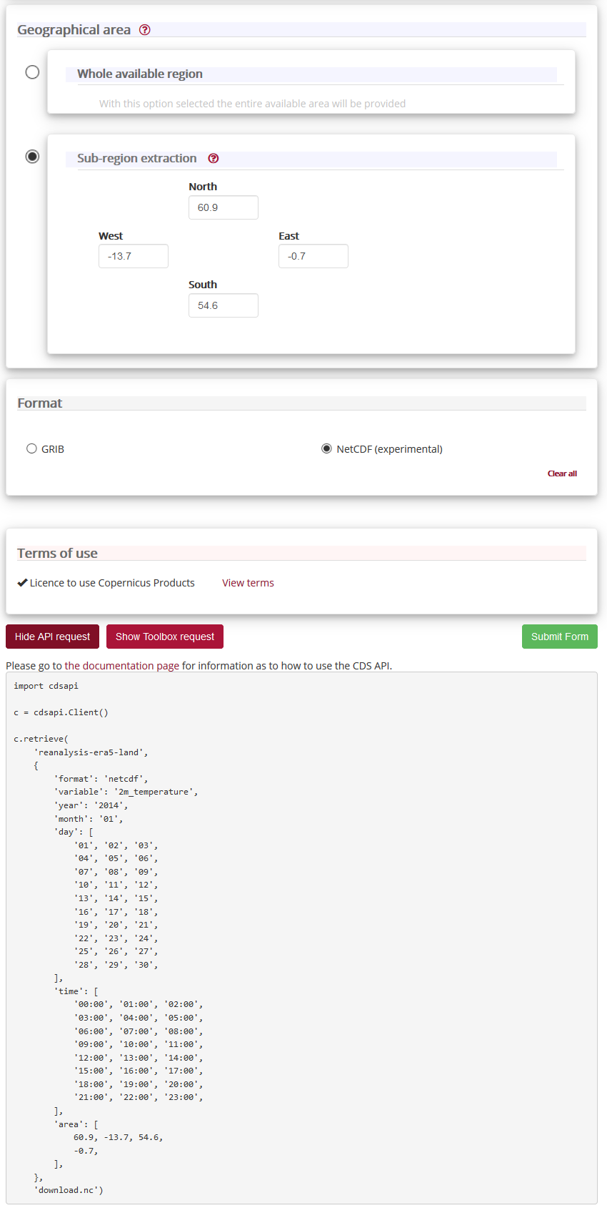
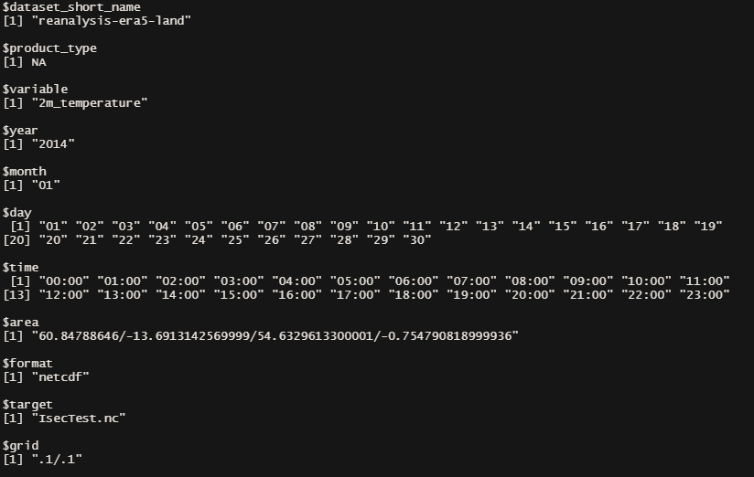
Why isn’t everyone using reanalyses?
Data Retrieval
Download Prerequisits
CDS account & API key (generated here)
ecmwfr package
Very unintuitive download specification
No processing of data
User Needs:
More intuitive download specification
Spatial data limiting beyond extents
Aggregation to desired temporal resolutions
Spatial Resolution
User Demands:
1km resolution
Statistical Interpolation:
Let users define the resolutions they need
Downscale reanalysis data from native resolutions on the user-end
KrigR provides a toolbox for all of this!

Slide 9
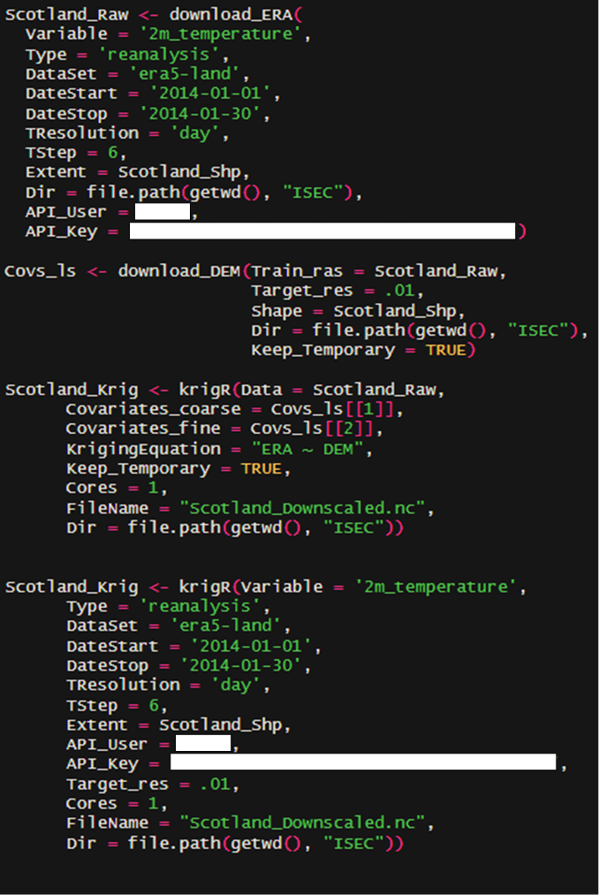
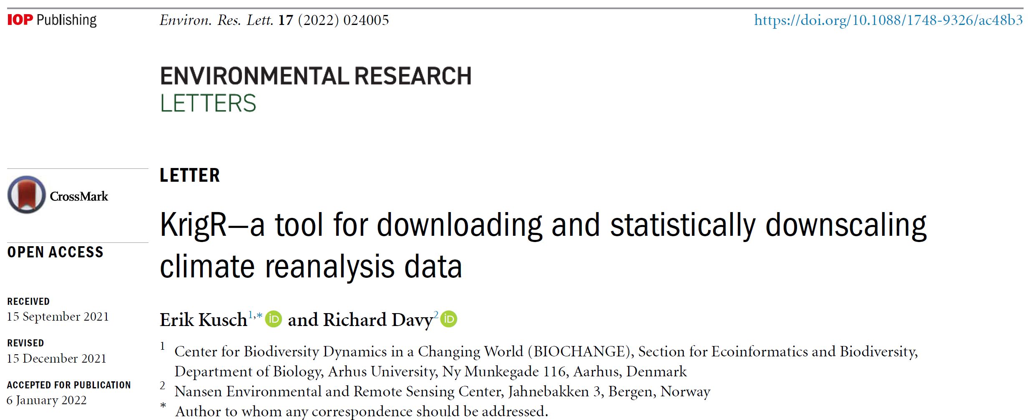
R-internal Workflow – 3 Steps
Era5(-Land) Data / Spatial product
Climate Data
&
Covariates
Covariates
(Training Resolution)
&
Covariates
(Target Resolution)
Kriging
Downscaled Product
Downscaling Standard Error
&

Slide 10
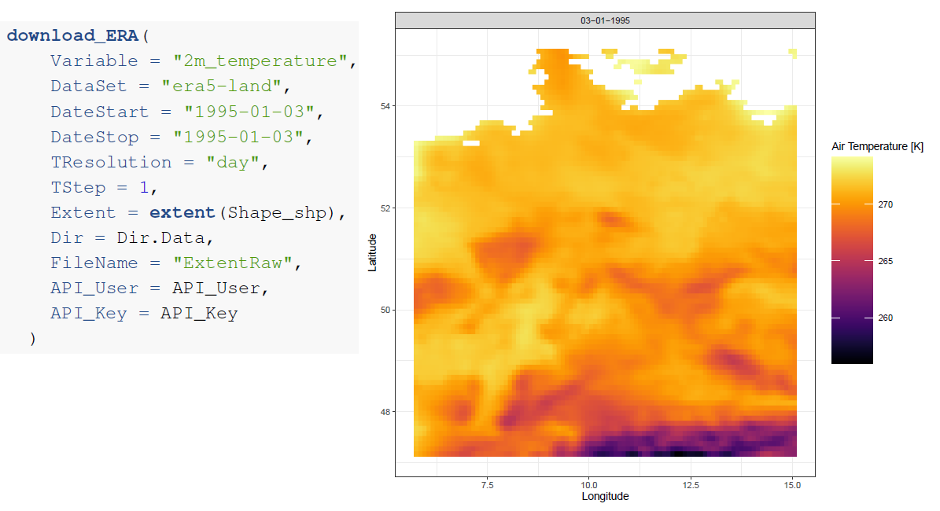
Climate Data – The Function Call
Climate Variable
Reanalysis Data Product
Time-Window
Temporal Resolution
Geographical Region
Directory where NETCDF will be stored
Name for NETCDF output
CDS API Credentials
download_ERA() has more arguments.

Slide 11
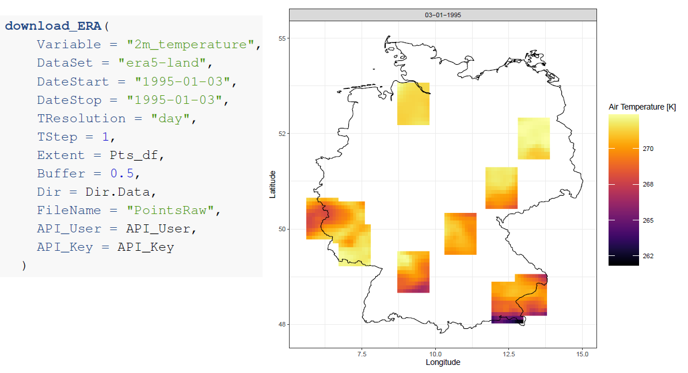
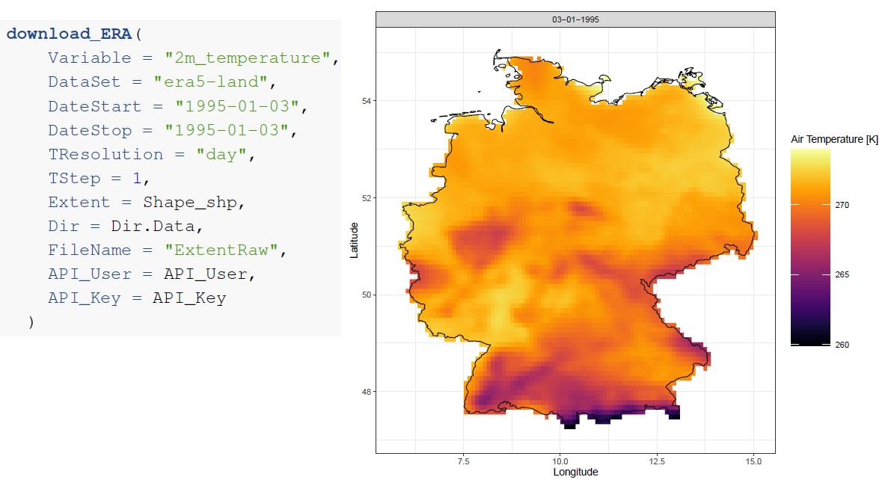
Climate Data – Shapefiles & Locations
download_ERA() can take shapefiles and point-locations.

Slide 12
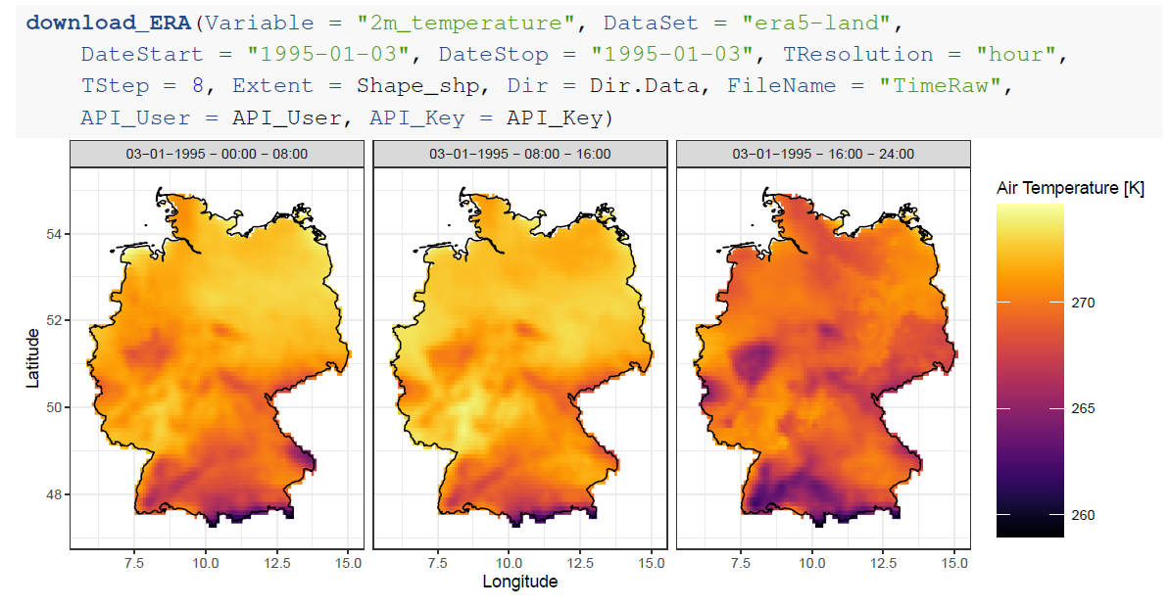
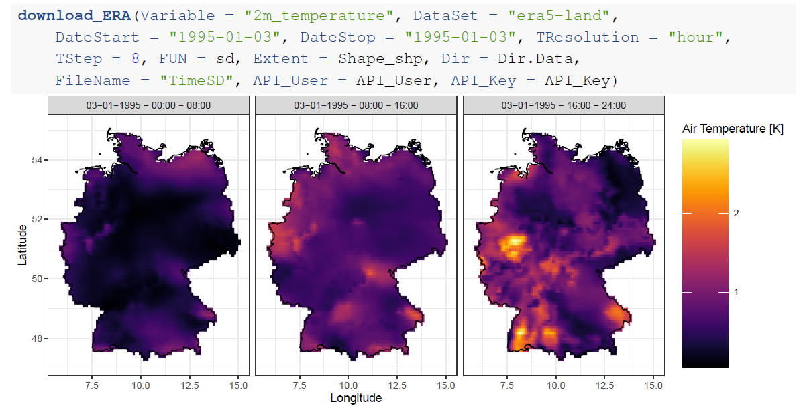
Climate Data – Time-Series
Setting the TResolution and TStep arguments in download_ERA(), you can achieve any temporal resolution you want.
The FUN argument in download_ERA() gives you control over aggregate metrics.

Slide 13
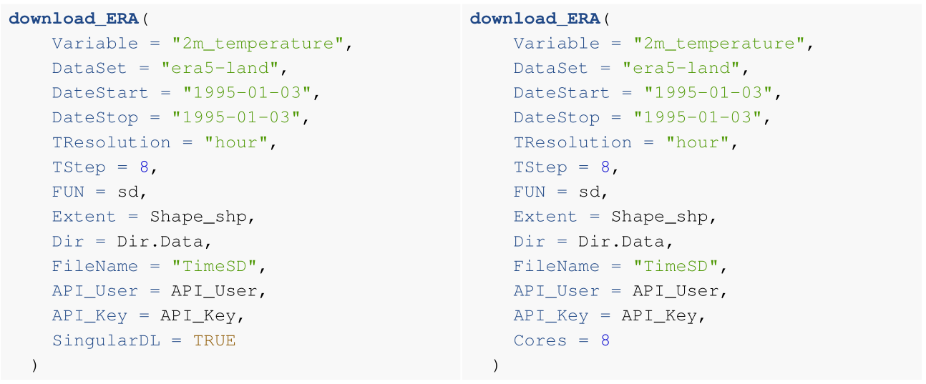
Climate Data – Efficient Downloads
Downloads of less than 100,000 layers of data can be forced to be staged as one call to the CDS with SingularDL.
Downloads can be sped up by staging them in parallel rather than sequentially using Cores.

Slide 14
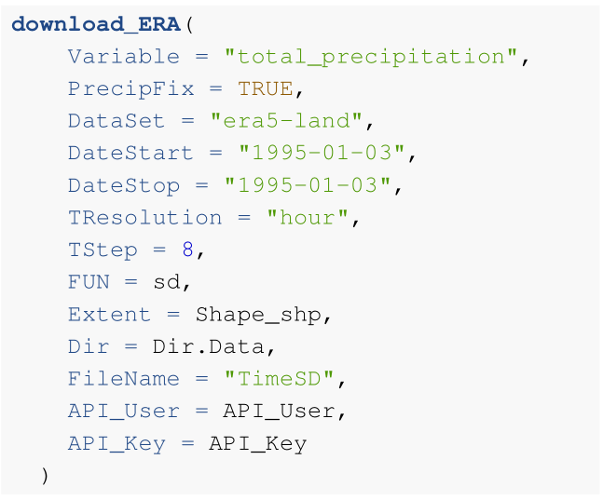
Climate Data – Consideration
Climate variables which are provided as cumulative records can be back-transformed into individual records by toggling the PrecipFix argument.
PrecipFix

Slide 15
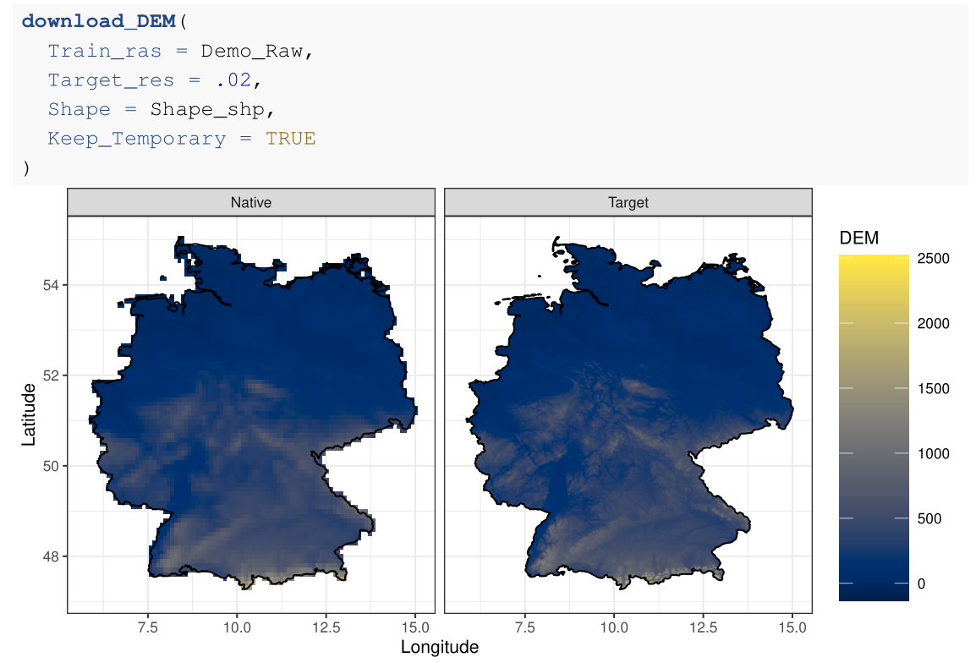
Covariates – The Function Call
Data you want to downscale
Target resolution (either a number, or a raster object whose resolution to match)
Optional, shapefiles or points like specified in download_ERA()
Whether to keep the GMTED 2010 data set on your hard drive
KrigR provides USGS GMTED 2010 digital elevation model data as interpolation covariates.

Slide 16
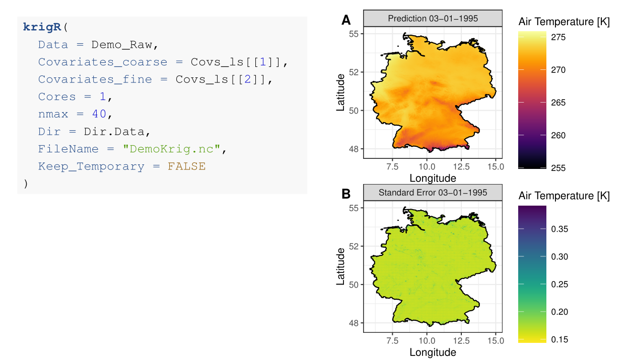
Kriging – The Function Call
Data you want to downscale
Covariates at training resolution
Covariates at target resolution
How many cores to use for kriging
Localisation of kriging
Directory where NETCDF will be stored
Name for NETCDF output
Whether to delete the temporary files (1/layer) upon completion
krigR() gives you parallel processing of multi-layer rasters and allows for pausing and restarting kriging via temporary files.
Kriging uncertainty can help you understand quality and robustness of your interpolated data.

Slide 17
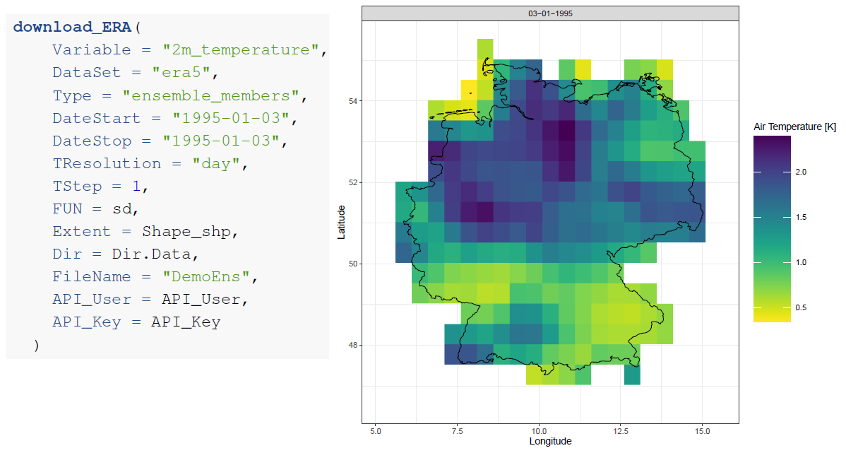
KrigR – Aggregate Uncertainty
By accessing reanalysis ensembles using the Type argument in download_ERA(), you can obtain dynamic uncertainty.

Slide 18
R-internal Workflow – 3 Steps
Era5(-Land) Data / Spatial product
Climate Data
Third-party data
&
Covariates
Covariates
(Training Resolution)
&
Covariates
(Target Resolution)
Kriging
Downscaled Product
Downscaling Standard Error
&

Slide 19
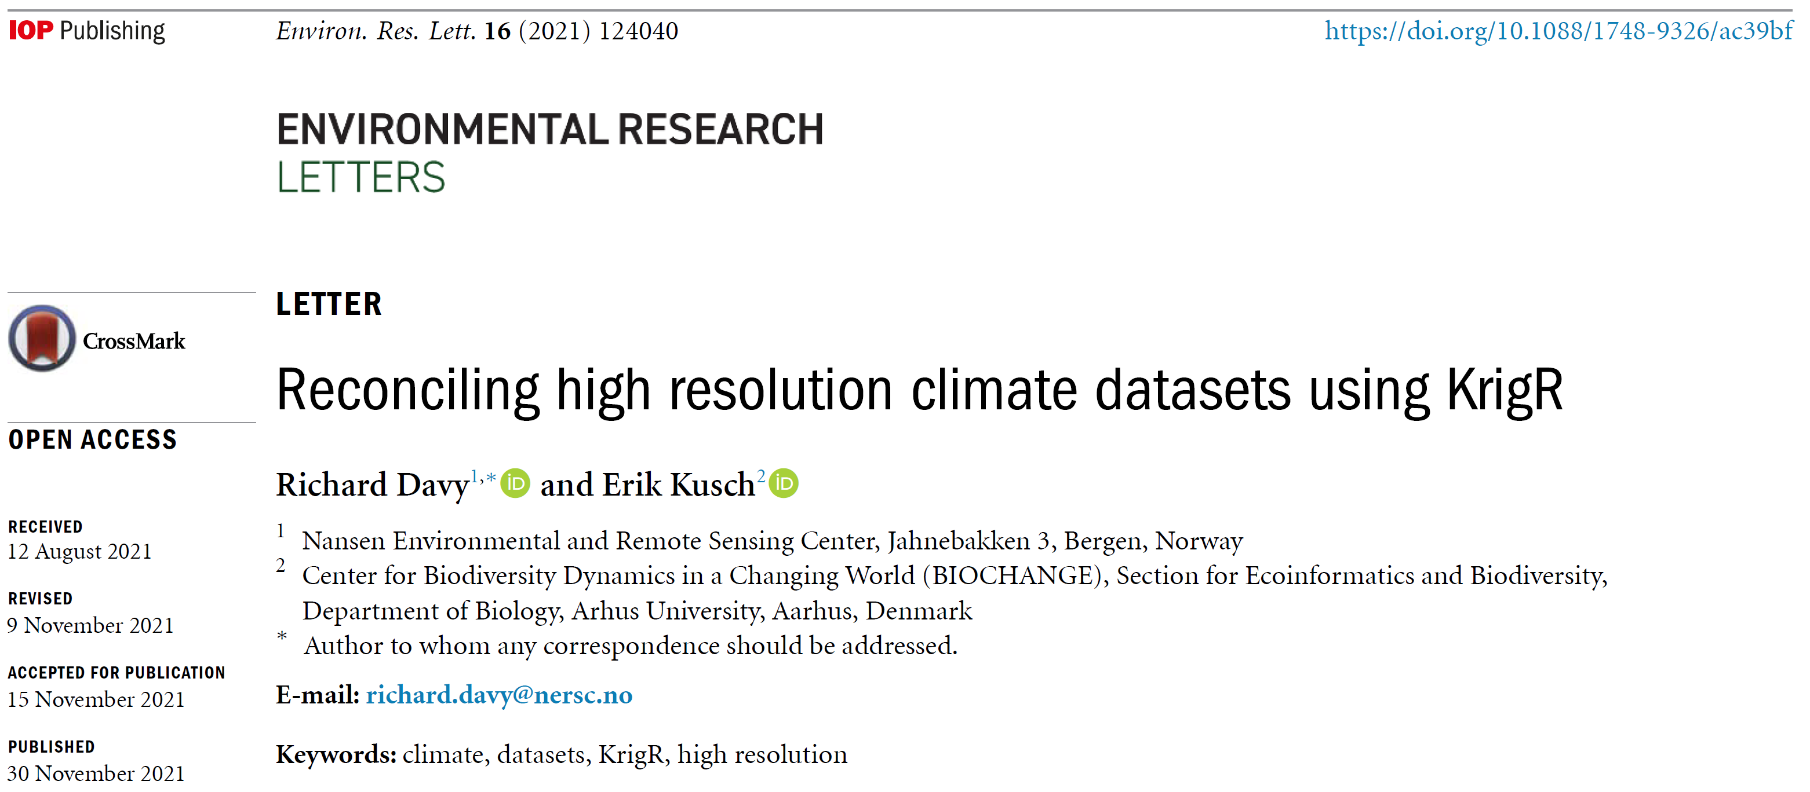
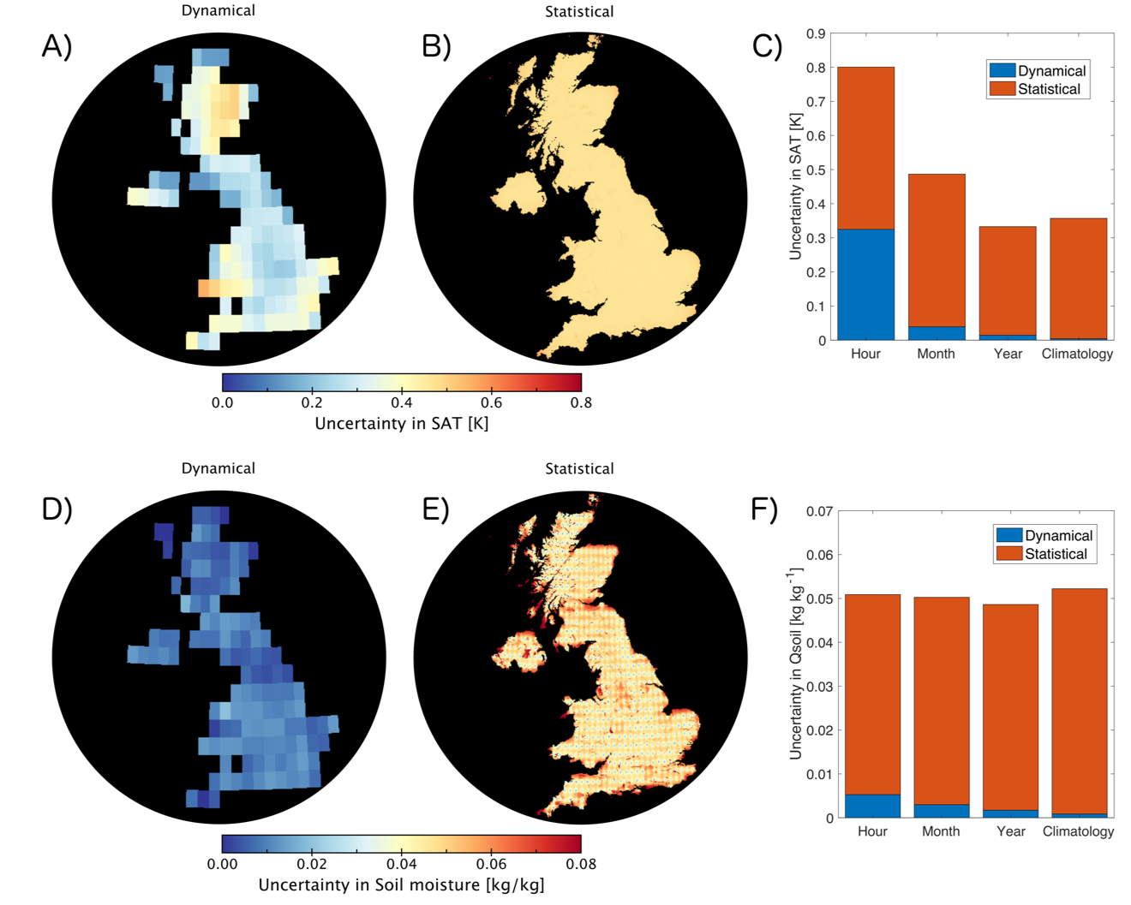


Kriging Uncertainty
1. Statistical interpolation uncertainty ($σ_{Krig}$) remains constant across temporal scales.
2. Dynamical uncertainty ($σ_{Dyn}$) of the underlying data diminishes as time-scales increase.
3. Both sources of uncertainty are important and should be propagated into downstream analyses.

Slide 20
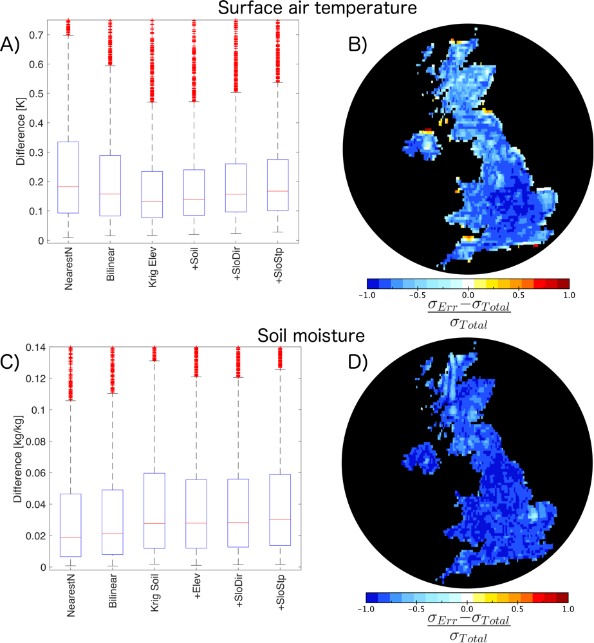

Kriging Accuracy
Testing Kriging Accuracy:
Krig upscaled ERA5-Land data to native resolution
Difference of upscaled & interpolated product ($σ_{Err}$)
Total uncertainty of kriged product: $σ_{Total}= \sqrt{\frac{σ_{Krig}^{2}+σ_{Dyn}^{2}}{2}}$
1. Kriging outperforms most other interpolation methods.
2. Kriging is highly accurate for a variety of ECVs.
3. Where Kriging is not the most accurate method, it is the only one that produces uncertainty estimates.

Slide 21
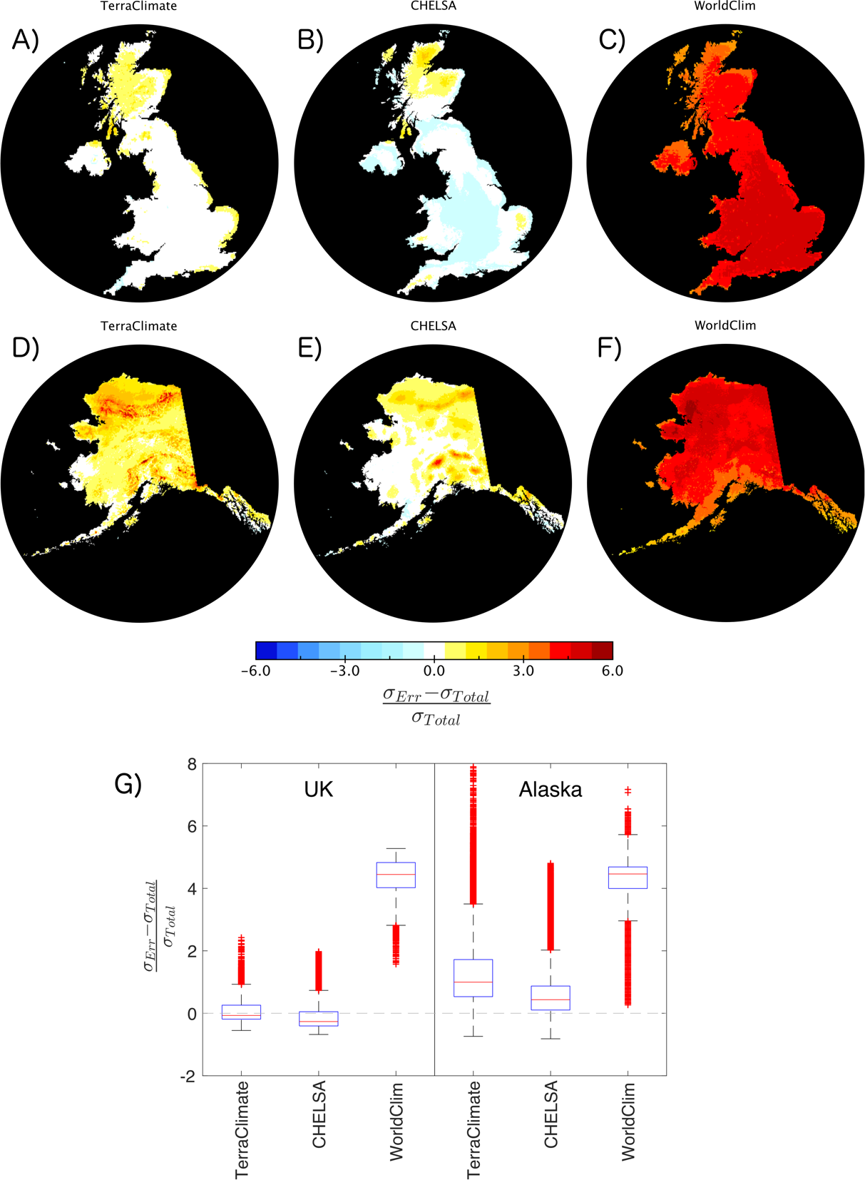
KrigR Products & Legacy Data
1. KrigR-products do not align with most legacy products.
2. Particularly, in topographically heterogenous regions, KrigR seems most reliable (i.e. accurate) and informative (through provision of uncertainty metrics) to us.

Slide 22
Using KrigR
Downloads ERA5(-Land)
Automatically breaks download request into sizeable chunks
Aggregates hourly/monthly data to user-specified temporal resolution and metric
Masks data according to shapefile / locations
Provides GMTED2010 data as covariates
Kriging of climate data
Checks for common errors
Parallelised processing of multi-bands
Exports kriging uncertainty
Temporary Files while kriging with krigR()
Temporary Directory in the directory indicated by Dir
Individual NETCDF (.nc) files for the kriging prediction and standard error of each layer in the input data
Removed automatically upon completion if Keep_Temporary = FALSE
Why?
You can put kriging on-hold, krigR() checks for the presence of temporary files for each run

Slide 23
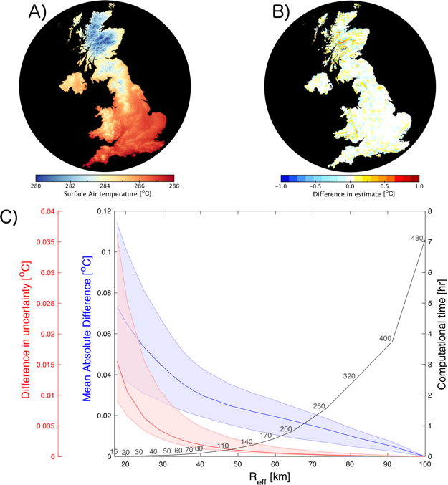
The Efficiency Of The KrigR Workflow
KrigR offers a flexible, efficient workflow
Data Storage & Downloads
Only download and store the data you need
→ Reducing storage demands and downloads sizes
Data Handling & Processing
Any temporal resolution & aggregate metric you need
Reliable & informative statistical interpolation via Kriging
Computational Cost
Processing time scales close to exponentially with extent and downscaling factor
→ Work on minimally required scales or localised kriging

Slide 24
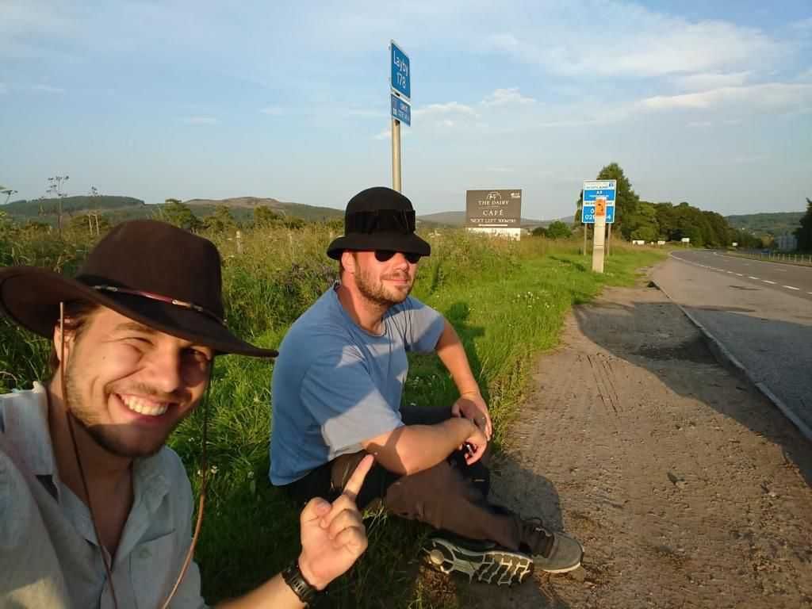
The Road Ahead For KrigR
What’s still to come?
More efficient downloads
Automatic splitting of download requests into maximum layer numbers
Support for more ECMWF data sets
ECMWF has voiced development interest
KrigR methodlogy for climate projections & data products
KrigR-based critique of bioclimatic variables & development of novel metrics
Use-case studies:
Vegetation dynamics (submitted publication)
Species distributions (planned publication)

